Slide 1

ENTITY-RELATIONSHIP MODEL - 2
Dr. Ejaz Ahmed

Slide 2
Objective
Weak Entity Types +
Higher Degree Relationships +
Refining the ER Diagram for the COMPANY Database +
Summary of ER Diagram Notations +
Alternative Notations for ER Diagrams +
Dr. Ejaz Ahmed

Slide 3
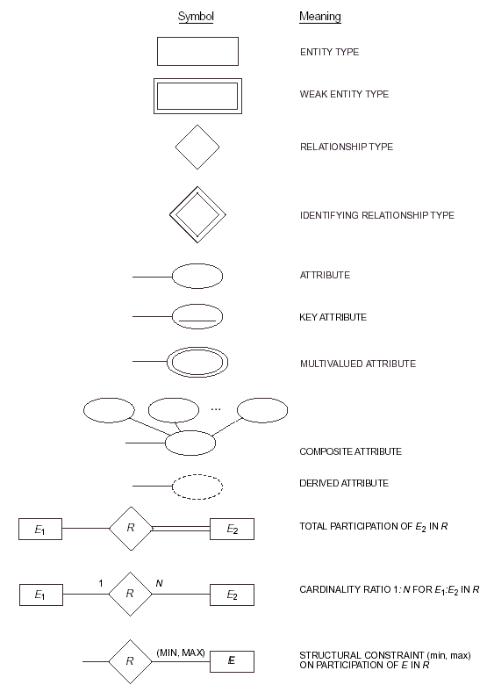
Summary of ER diagram notation.
Dr. Ejaz Ahmed

Slide 4
Weak Entity Types …
An entity whose existence depends on some other entity type is called a weak entity type. Otherwise, it is called a strong entity type. There is a chance of records’ duplications on non-key attributes.
Entities belonging to a weak entity type are identified by being related to specific entities from another entity type in combination with some of their attribute values.
We call this other entity type identifying, or owner, entity type and we call the relationship that relates a weak entity type to its owner type the identifying relationship type of the weak entity type.
Dr. Ejaz Ahmed
Notes:
Weak means: Weakness of populating duplicate records in child (dependent) entity. There is a chance of populating duplication records. Surrogated key is used along with pK of parent table in child table

Slide 5
Weak Entity Types
A weak entity type always has a total participation constraint with respect to its identifying relationship type.
Weak entity types are uniquely identified by a partial key that will be added to the key of the strong entity type that it is associated with. In the ER digram a partial key is a dashed underline.
For example, in the COMPANY database, the DEPENDENT entity type dependes on the existence of the EMPLOYEE entity type, i.e. no dependent will exist in the database unless at least one of his/her parents works as an employee in the company.
The DEPENDENT entity type has the dependent name as a partial key that will be added to the SSN of the employee who is associated with, to uniquely identify the dependent.
Dr. Ejaz Ahmed
Notes:
Weakness in entity means there is a chance of duplication of record while using surrogated key. All columns’ values can be duplicated except surrogated key

Slide 6
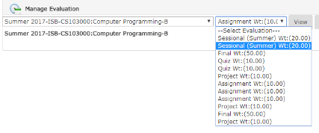
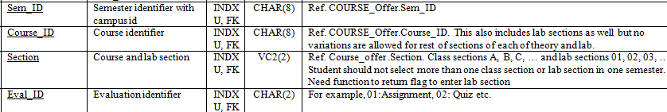
Week Entity – Duplications Example
Dr. Ejaz Ahmed
Notes:
Add column Max_Marks. All cordinated courses must have same marks distributions of evaluations in same course of semester

Slide 7
Weak Entities …
All ID-Dependent (identified) entities MAY BE considered weak.
  Examples: ATM Card & Transactions, Patient and Patient visits, Patient & Issue Medicines, Employee & Dependent Family Members, Loan and its Installments
But there are also some non-ID-dependent weak entities.
  The identifier of the parent does not appear in the identifier of the weak child entity in ER Diagram.
5-<number>
Dr. Ejaz Ahmed
Notes:
In hospital, Patient & Issue Medicine are managed through Visit. In Pharmacy, Patient & Issue Medicine are managed directly with identifying relationship & weak. In general, medical standards are adopted, no medicine will be issued without visit. Some special medicines can be issued but will be managed through emergency or some other ways.

Slide 8
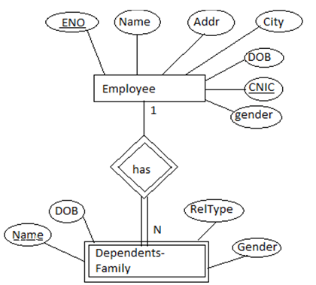
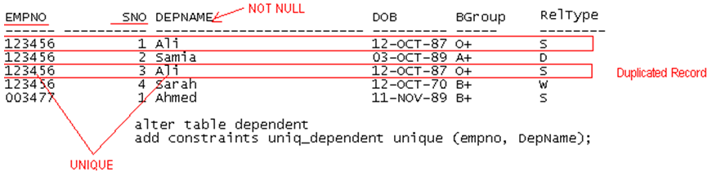
Identifying & Weak Entity - Example
EMPLOYEE(ENO, Name, Gender, DOB, Addr, City, CNIC)
Dependent(ENO, SNO, Name, Gender, DOB, RelType)
Dr. Ejaz Ahmed
Notes:
Enterprise is any ABC company, or you can consider FAST university where people are working as an employee
Weak means: Weakness of populating duplicate records in the child (dependent) table (Chances of duplications). Surrogated key is used along with PK of parent entity in child entity
You have mentioned that CNIC# (through B-form) can be a key with empno in dependent table then dependent will be a strong entity.
In weak entity, normally child key is meaningless to user or organization or if emp could not provide B-Form or CNIC# for some reasons then record will be not be entered until CNIC is provided. To handle such delay, normally designers prefer SNO. CNIC# column can be provided with NULL, can be entered later when provided. This will be a flexibility in design.

Slide 9
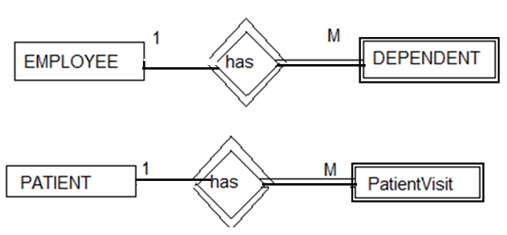
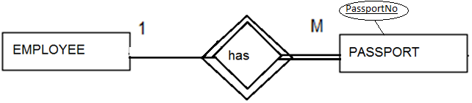
Examples …
Employee, Passport are ID Dependent (identifying) but not weak entities. Whereas Student, CourseTaken would be …
Dr. Ejaz Ahmed
Notes:
PatientVisit can be strong entity with identifying relationship if designer can assign unique fixed length identifier just like Invoice#
Passport can be renewed (identifying and weak) or new passport can be issued after expiry of passport (Only identifying)

Slide 10
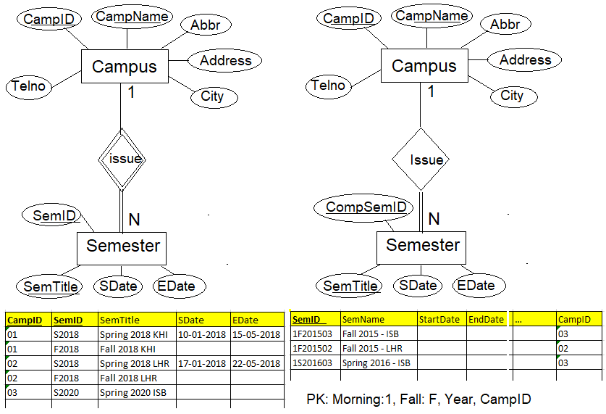
Two ways – one example
Notes:
Weak entity is not allowed in this example as semester has its own well defined key identifier.
Director is the Head or boss of campus: 1-1 relationship between Campus & Employee.

Slide 11
Higher Degree Relationships
In many instances, it is required to represent relationship that is of a degree higher than 2 (HD), i.e. it involves more than two entity types.
Sometime these relationships can be represented using binary relations, although sometime this may not give the same meaning.
For example the tuple (s, p, j) which states that SUPPLIER s supplies PART p to PROJECT j may not be expressed by the three tuples (s,p), (s,j) and (p,j).
Dr. Ejaz Ahmed

Slide 12
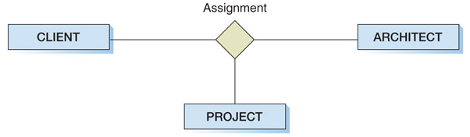
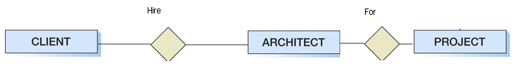
Ternary Relationship
This is M-N relationship
Below is a data flow diagram or flow-chart, but it is NOT an ER Model
Other example can be Employee, Job and Bank-Branch
Dr. Ejaz Ahmed

Slide 13
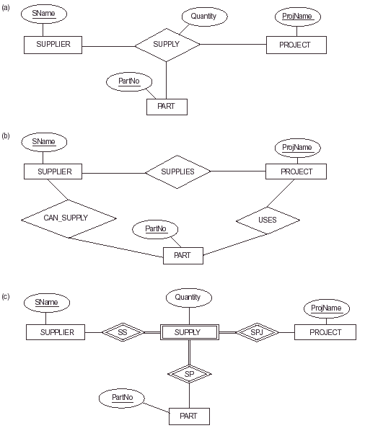
Higher Degree Relationships
Note: (b) is not ternary relationship
Other Examples are: Student, Semester, Course; Instructor, Semester, Course;
Candidate, Company, Interview; Campus, Departments, Schools for our univ.)

Slide 14
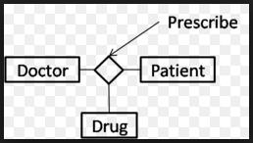
Suitability of Ternary Relationship
Following relationship is not correct, why?
Ternary relationship is not valid for Instructor, Course & Semester
Dr. Ejaz Ahmed
Notes:
Doctor cannot prescribe any drug without the issuance of visit# of a patient. In ternary, all entities must be participated means doctor may not prescribe any drug

Slide 15
Case Study
In your university library members issue books and
return back issued books.
Draw an ER Diagram with mapping and data sets
Dr. Ejaz Ahmed

Slide 16
Alternative Notations for ER Diagrams …
There are many alternative diagrammatic notations for displaying ER diagrams.
Appendix A of the text book, “Fundamentals of Database Systems” by Elmasri and Navathe, gives some of the more popular notations.
Later in the course we will introduce the Universal Modeling Language (UML) notation, which has been proposed as a standard for conceptual object modeling.
Dr. Ejaz Ahmed

Slide 17
Alternative Notations for ER Diagrams …
Here we will describe one alternative notation for specifying structural constraints on relationships. This notation involves associating a pair of integer number (min, max) with each participation of an entity type E in a relationship type R, where 0 <= min <= max and 1 <= max
The numbers mean that for each entity e in E, e must participate in at lease min and in at most max relationship instances in R at any point in time.
In this method, min = 0 implies partial participation, where as min > 0 implies total participation.
Dr. Ejaz Ahmed

Slide 18
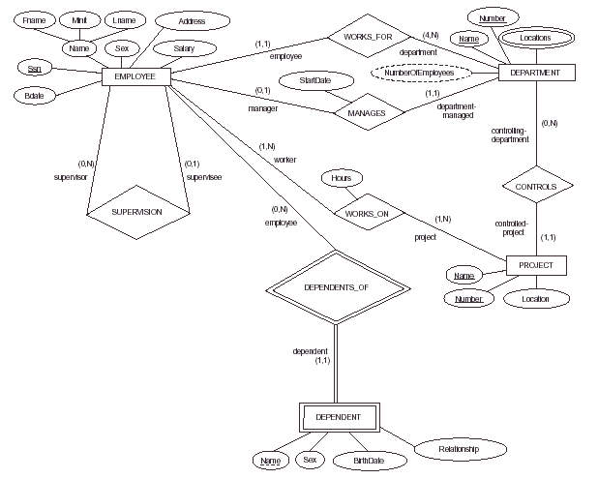
Another E-R Model representation of the COMPANY Database
Dr. Ejaz Ahmed

Slide 19


Relationship’s Meaning
Any department has at least one or more than one employee. There are some employees who do not have department
• Plant - an organizational element within a company. A plant produces goods, renders services, or makes goods available for distribution. A plant can be a manufacturing facility.
• Storage location – an organizational unit within a plant. A storage location identifies the general area in the plant where material is stored. Plants can have multiple storage locations.
5-<number>
Dr. Ejaz Ahmed

Slide 20

Binary Relationship
Exercise: Students are enrolled in a Course and each Course has one recommended Book. Same Book is assigned to more than one Courses.
Exercise: A person drives a car. Person owns many cars.
Exercise: Students enroll in many courses with semester
Dr. Ejaz Ahmed

Slide 21




Entity Parts or Items
Many issues can be considered, for example Consumable or fixed items or parts etc.
What are the possible attributes are needed for some entity?
Dr. Ejaz Ahmed

Slide 22
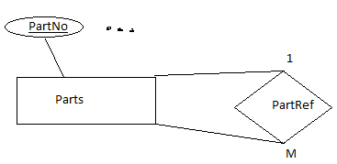
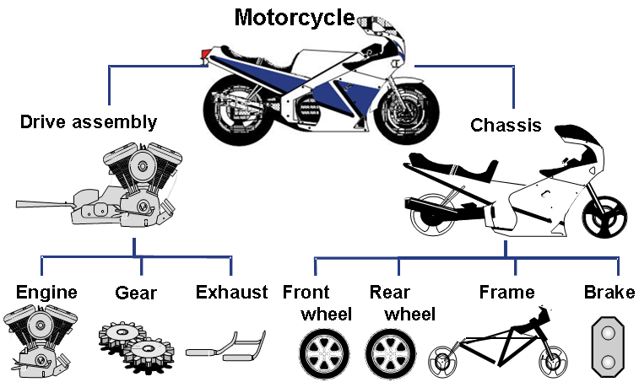
Exercise – ER Model & Mapping
Part (Part#, PName, Weight, MakeYear, Price, PType, RefPart#)
PType: Assembled product/ parts (e.g., Motorcycle) or single part
Dr. Ejaz Ahmed

Slide 23
Item’s Price History (Indentifying & Weak)
Item(Item#, Name, Descr, Sprice, Pprice, Qty)
ItemPriceHistory(Item#, SNO, PriceDate, SPrice, PPrice)
Other example can be Loan and its Instalments payments
Make Questions for possible ER and Datasets
Dr. Ejaz Ahmed
Notes:
Make Questions for possible ER and Datasets

Slide 24
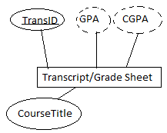
Entity Validity - Example
SECTION is not an entity because it contains serial numbers such as 01, 02, …
Or A, B, C etc. Section with Descr. can be
Transcript is not an entity, why?
Entity must contains more than
one records & more than one columns
SEMESTER is an entity because it contains attributes such as
SemesterID: 091
SemesterStartDate: 12/02/2010
SemesterEndDate: 22/06/2010
SGPA: 2.58 (Calculated attribute)
Dr. Ejaz Ahmed

Slide 25
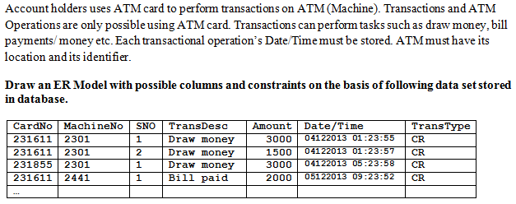
Exercise
Dr. Ejaz Ahmed

Slide 26
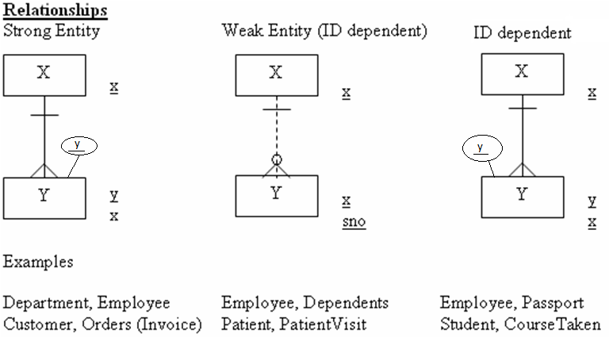
Summary – Strong & Weak Entities
5-<number>

Slide 27
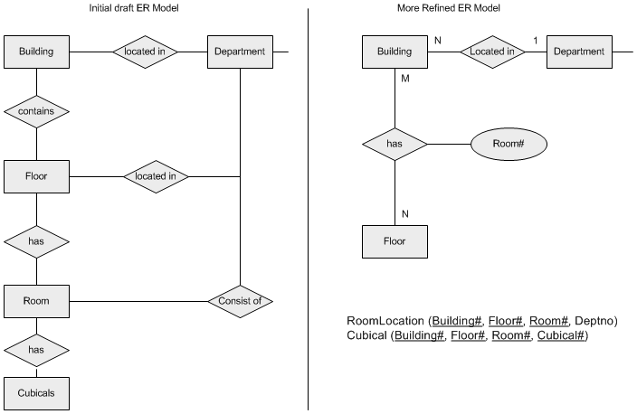
Practical Exercise – Draft to Refine Shape versions
Make at least 3 versions of one ER Model to get optimum solution
Dr. Ejaz Ahmed

Slide 28
Summary of ER Diagram Notations
The cardinality ratio of each binary relations, such as WORKS_FOR, is specified by placing a 1, M or N on each participating edge.
The participation constraint is specified by a single line for partial participation and double lines for total participation.
For recursive relationship type, such as SUPERVISION, the different role names of the entity type are placed on the different edges of the relationship type.
Dr. Ejaz Ahmed

Slide 29
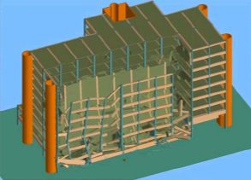
If you don’t follow design/ model then …
Dr. Ejaz Ahmed
Notes:
Weak design and no-designs have long terms affects. Application or system will destroyed slowly in years and at the end decision will be made to re-design new system with strong designing principles with new technology.

